Slide 1
VESTIBULAR FUNCTIONS
Tania Warnakulasuriya
Department of Physiology

Slide 2
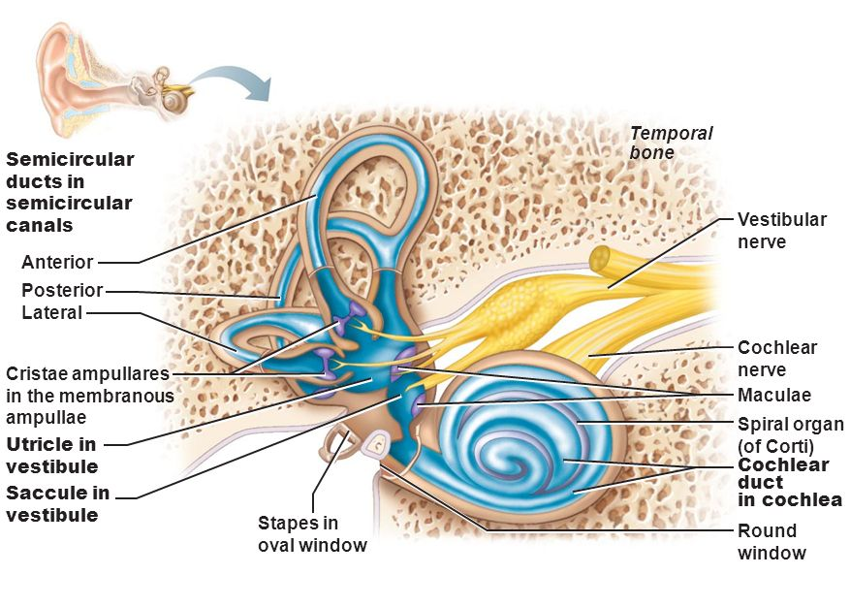
Vestibular apparatus
Sensory organ detecting sensation of equilibrium
Composed of bony tubes ( bony labyrinth)
Located in petrous part of temporal bone
With in the bony labyrinth lies the membranous labyrinth
Membranous labyrinth is composed of membranous tubes and chambers
Membranous labyrinth is the functional part of the vestibular system
Semicircular canal
Utricle
Saccule

Slide 3
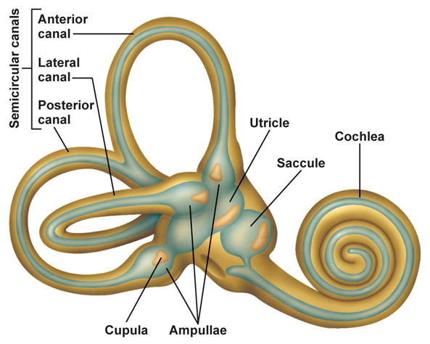
Membranous labyrinth
Main parts
Semicircular canals
Rotational acceleration
Utricle
Linear acceleration - horizontal
Saccule
Linear acceleration - vertical
And the cochlea – major sensory organ for hearing

Slide 4
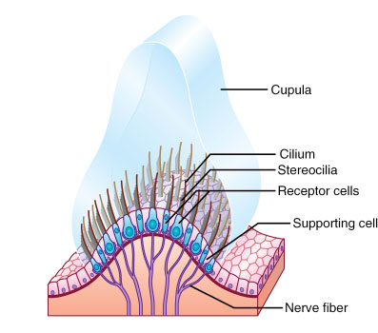
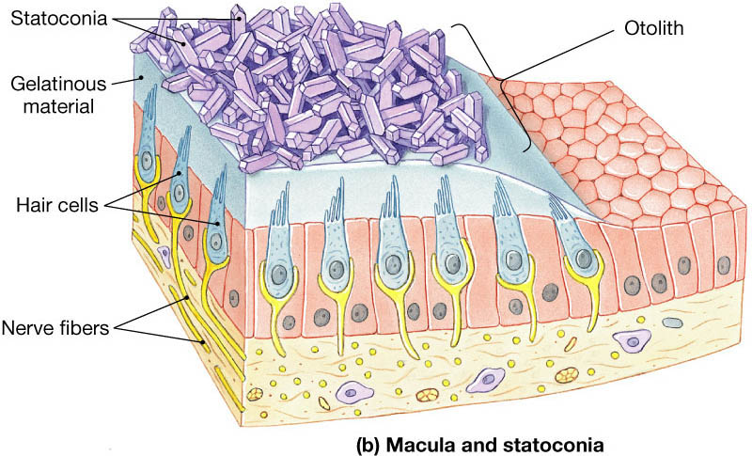
Sensory organs in the membranous labyrinth
Utricle and Saccule-
Macula
Semicircular canal-
Crista ampullaris

Slide 5
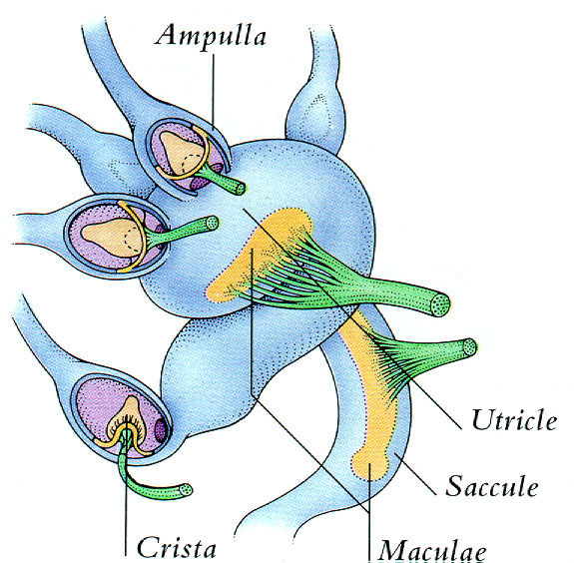
Maculae
Sensory organ in the utricle and saccule
Sensory area ~2mm in diameter
Utricle – horizontal plane-
Saccule – Vertical plane

Slide 6

Macula
Base of the macula- Hair cells ( many thousands) with cilia projecting out.
Covered by a gelatinous layer.
Statoconia - small calcium carbonate crystals are embedded in the gelatinous layer. Weight of statoconia bend the cilia towards the gravitational pull.
Sides and base of hair cells synapse with sensory ending of vestibular nerve.
Sustentacular cells

Slide 7
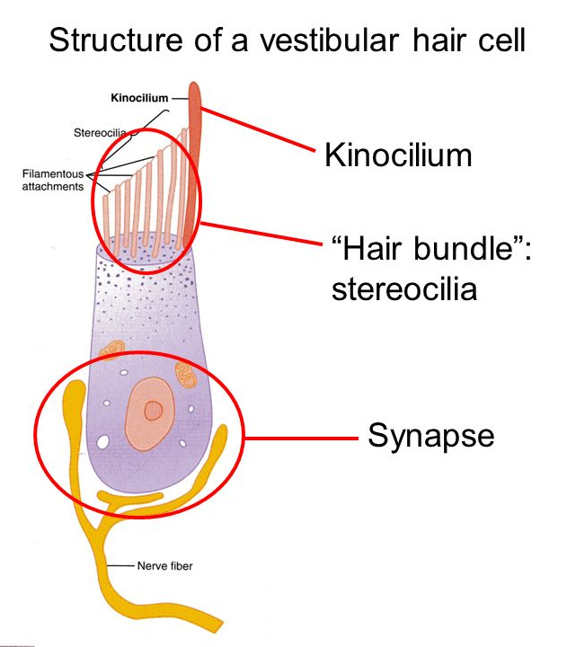
Hair cell
Each hair cell has 50-60 small cilia - stereocilia
One large cilium – kinocilium
Arranged in ascending order
Minute filamentous attachments between cilia connect the shorter cilia to the next long one and the longest stereocilia to the kinocilium
Under normal resting conditions – nerve fibers from the hair cells transmit impulses at a rate of 100/sec

Slide 8
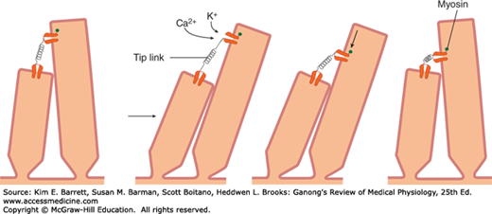
Movement of cilia and receptor potential
Bending the stereocilia to the kinocilium tugs the filamentous attachments
open cation channels
Positive ions come inside the cell
Receptor membrane gets depolarized
Increase in impulse transmission in the nerve fibers

Slide 9
Movement of cilia and receptor potential
Bending the stereocilia backward to the kinocilium
Reduce tension in filamentous attachments
closes cation channels
Receptor membrane gets hyperpolarized
Reduction or complete stop in impulse transmission

Slide 10
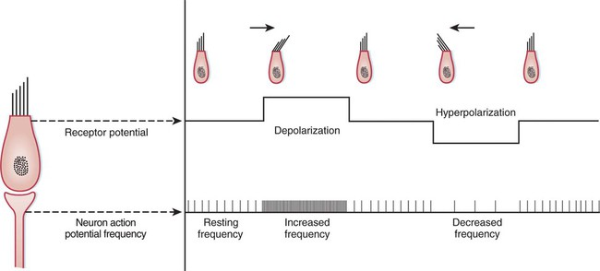
Receptor potential of a hair cell and vestibular nerve action potential frequency

Slide 11
How does the brain identify the bending of the head
In each macula, hair cells are oriented in a different direction.
Some are stimulated with forward bending of the head
Some by backward bending of the head
The pattern of excitation in the macular nerves will be different for each orientation of the head in the gravitational field.
Brain recognizes this pattern as the head orientation in space

Slide 12
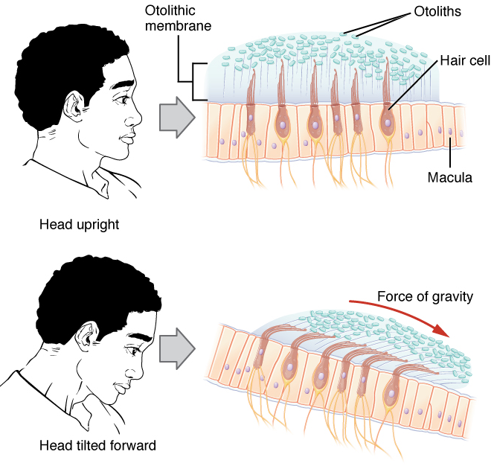
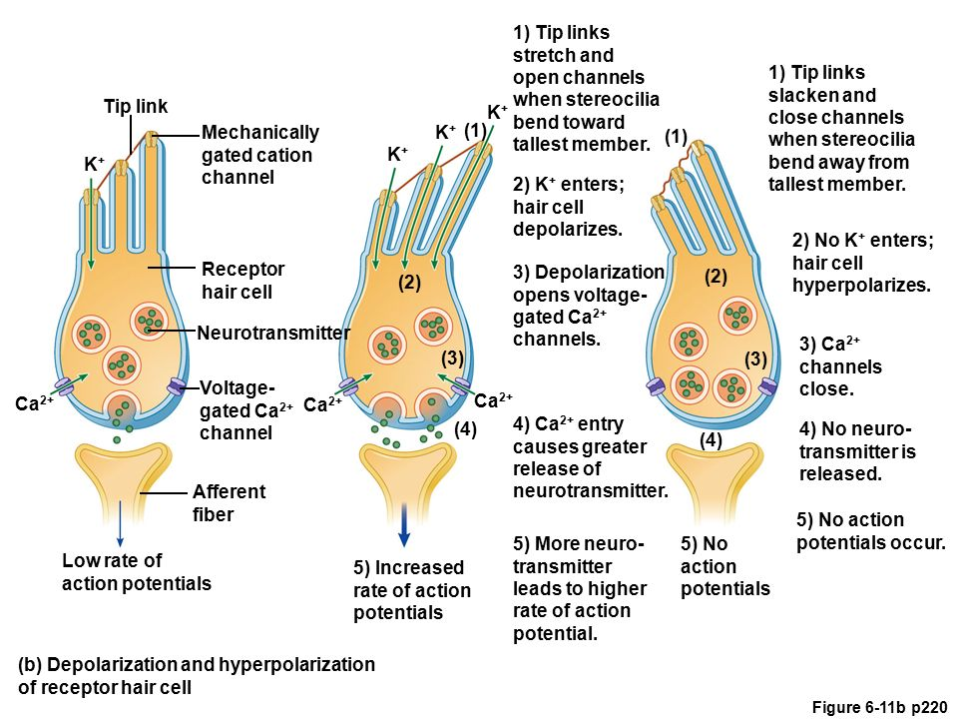

Slide 13
Static Equilibrium
Brain will be appraised of the position of the head with respect to direction of gravity
Vestibular, cerebellar and reticular motor nerve systems of the brain will excite posture muscles
Maintain equilibrium
The utricle and saccule system functions most effectively in the near vertical position

Slide 14
Linear acceleration
On accelerating forward
Statoconia ( greater mass inertia than surrounding fluid) fall backward
Gives the feeling of disequilibrium- feeling of falling backward
Causes the person to lean forward to equalize the shift of statoconia
At the point where the nervous system detects a state of proper equilibrium the body leans no further

Slide 15
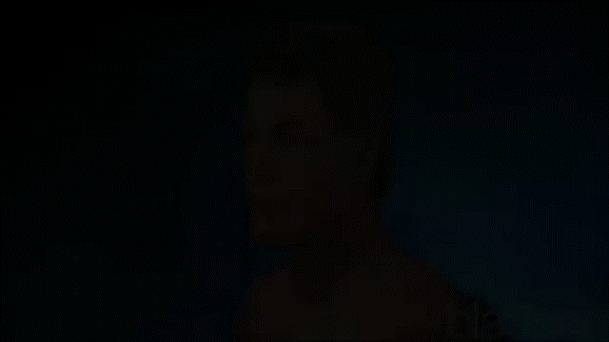

Slide 16
Question
Which of the following are true regarding the vestibular apparatus?
A) Semicircular canals detect rotational acceleration.
B) Utricle detect linear horizontal acceleration.
C) Saccule detect linear vertical acceleration.
D)The sensory organ in the utricles are crista ampularis.
E) The sensory organ in the saccule are maculae.
TTTFT

Slide 17
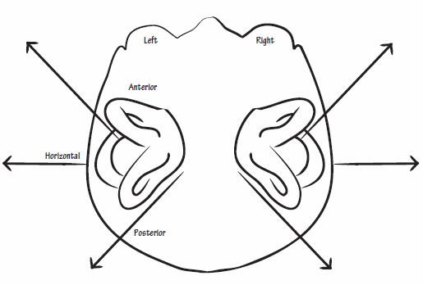
Semicircular canals
Anterior
Posterior
Lateral ( Horizontal)
Arranged right angles (90⁰) to one another.
Represent all three planes in space.
Filled with endolymph
Each semicircular canal has an enlargement at one end- ampulla
Ampulla contain crista ampullaris

Slide 18
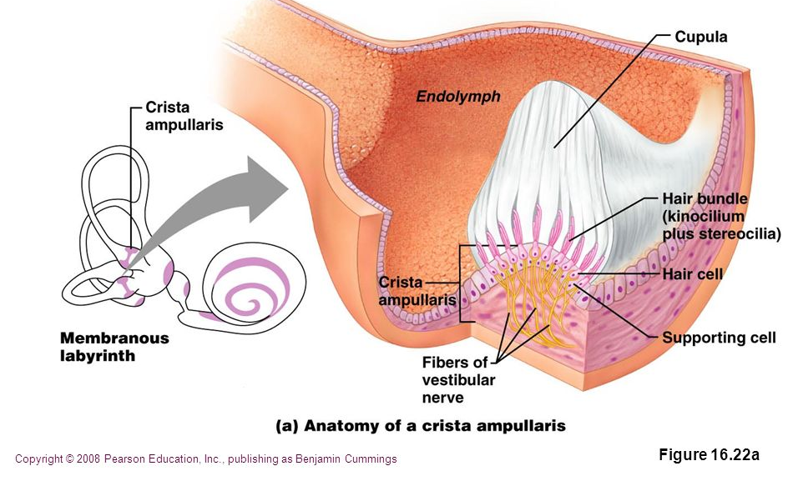
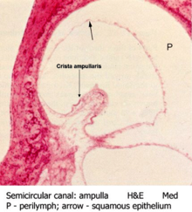
Crista ampullaris
Composed of hair cells
Hairs are embedded in a loose gelatinous tissue mass- cupula

Slide 19
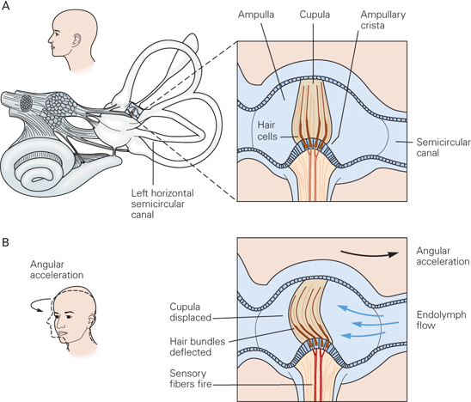
Detection of rotation
When the head rotates, the bony labyrinth rotates with the head.
Inertia of fluid make it remain stationary.
It is as if fluid is flowing in the opposite direction.
Cupula will bend in the direction of flow.

Slide 20
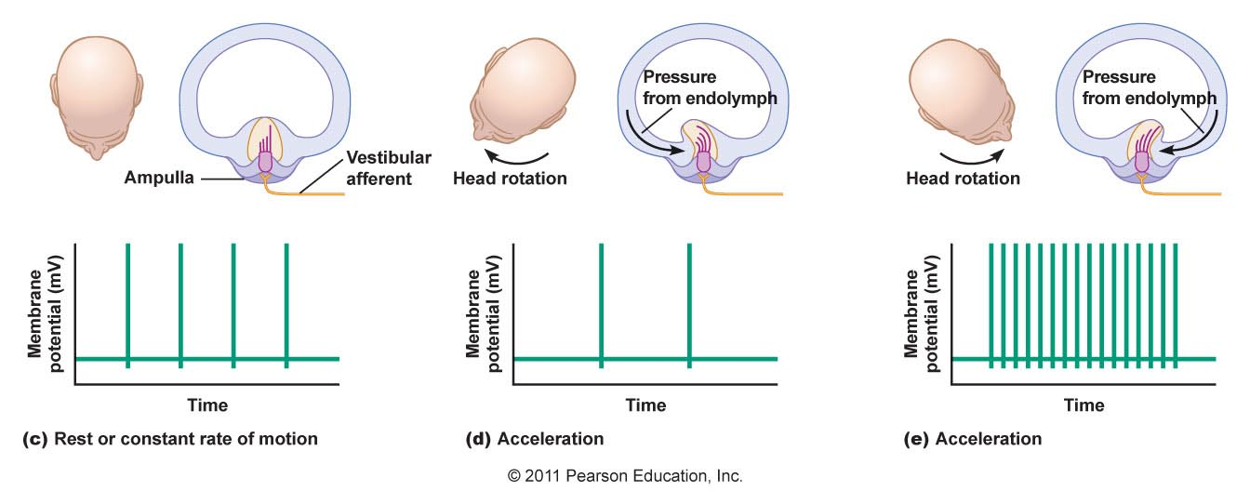
Detection of rotation
Kinocilia of the hair cells in the ampullary crest are all oriented in the same direction in the cupula
Bending of the cupula in one direction cause depolarization;
bending of the cupula in the opposite direction causes hyperpolarization.

Slide 21
Changes to impulse rate with rotation
At resting stage there is a tonic discharge of ~100 impulses /sec
At the initiation of rotation- increase in rate of discharge
With continued rotation the fluid achieve the same momentum as the bony labyrinth and there is no relative motion.
Cupula returns to the resting position due to elastic recoil
The rate of discharge by the hair cells in crista ampullaris reduce to the baseline levels.

Slide 22
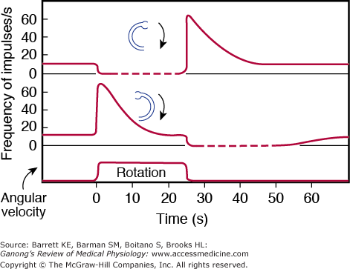
Changes to impulse rate with cessation of rotation
When the rotation stops the endolymph continues to rotate.
Cupula now bends in the opposite direction.
Stop discharges from the hair cells in crista ampullaris.
When endolymph stops moving in another few seconds cupula returns to the resting stage and fire the tonic level.

Slide 23
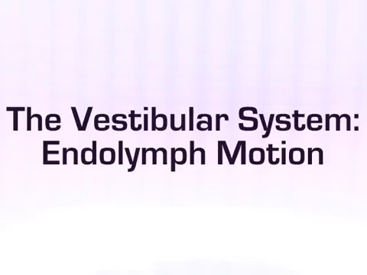

Slide 24
Appraisal of rotation by the brain
The vestibular nerve impulses tells the central nervous system of the
A) change in the rotation
B) rate of change in rotation
In each of the three planes of space.
The semicircular canals are important for the maintenance of equilibrium in rapid , intricate changes in body movement – dynamic equilibrium.
( do not play a part in static equilibrium or steady directional or rotational movement)

Slide 25
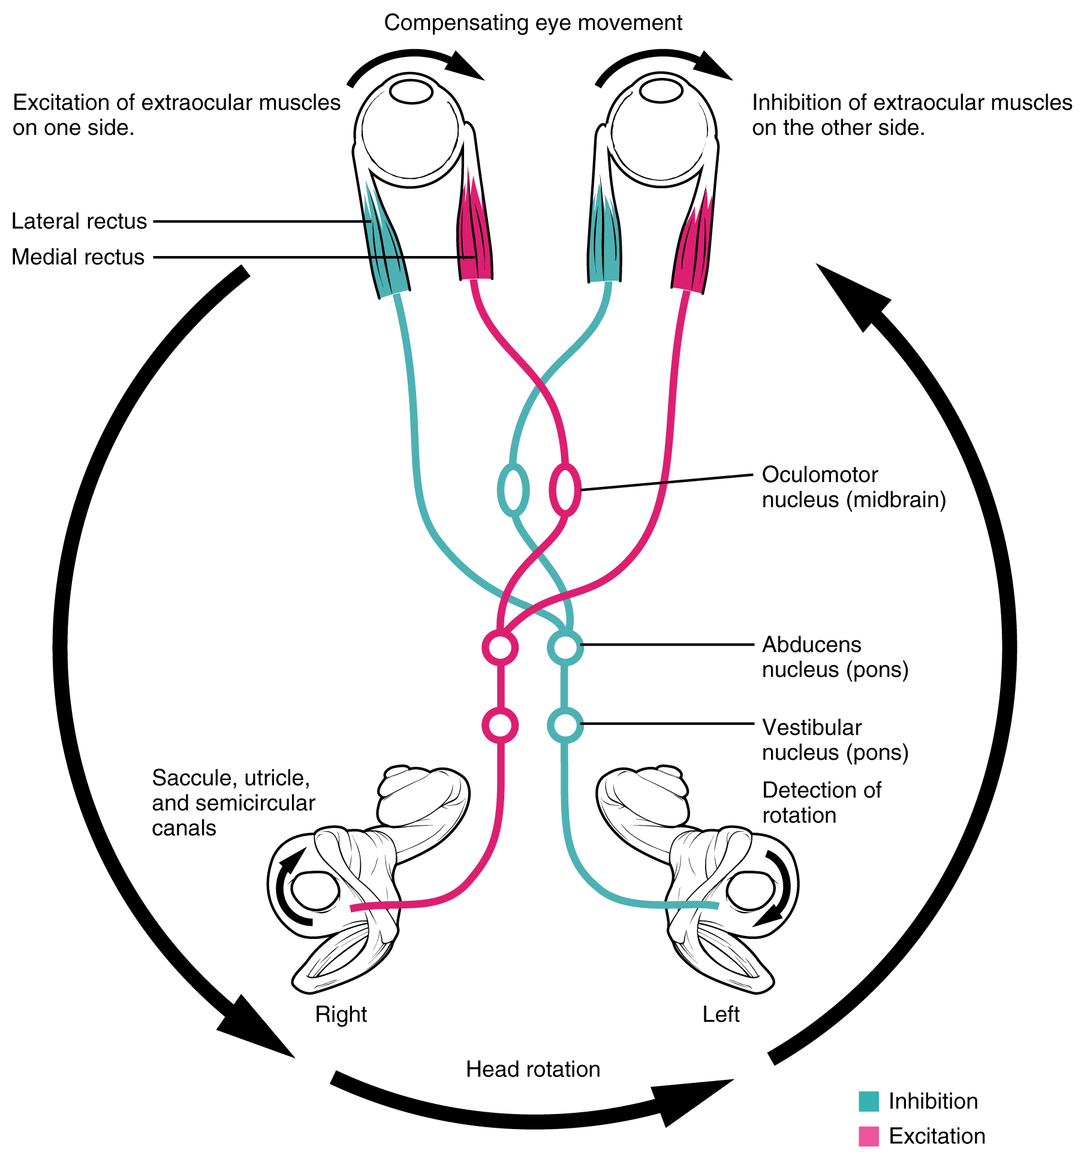
Vestibular mechanism stabilizing the eye
Detection of rotation by the semicircular ducts
Reflex transmission through vestibular nuclei and medial longitudinal fasciculus
Oculomotor nuclei

Slide 26
Nystagmus
Increase discharge from semicircular canals
Sudden movement of the head
Gaze moves to the opposite direction (slow component of nystagmus)
Reflex movement of the eyes
(vestibulo-ocular reflex)
Eyes jump forward and fix upon a new object in view (fast component )
Regulated by centers in brainstem
Head continues to turn

Slide 27
Other factors maintaining equilibrium
Neck proprioceptors
Joint receptors of the neck
Proprioceptive and exteroceptive information from the body
Pressure sensation from foot pads
Air pressure sensation
Visual mechanisms- shift of visual images on the retina
Notes:
Neck proprioceptors
Joint receptors of the neck
Send impulses directly to the vestibular and reticular nuclei or via the cerebellum.
Proprioceptive and exteroceptive information from the body
Pressure sensation from foot pads
Air pressure sensation
Visual mechanisms- shift of visual images on the retina

Slide 28
Neuronal connections of the vestibular apparatus
At the junction of the medulla and the pons lies the vestibular nucleus
Most vestibular nerves terminate at the vestibular nucleus
Some pass to the reticular nuclei in the brain stem
Some to the cerebellum ( fastigial, uvular and flocculonodular lobe)

Slide 29
Neuronal connections of the vestibular apparatus
From the vestibular nuclei, second order neurons pass to,
Cerebellum
Vestibulospinal tract- selectively control the excitatory signals to the different antigravity muscles to maintain equilibrium
( muscles of the vertebral column and the extensor muscles of the limbs)
Medial longitudinal fasciculus
Other brain stem areas(eg: reticular nuclei)

Slide 30
Reticular nuclei
Pontine reticular nuclei- excite antigravity muscles.
Medullary reticular nuclei – relax antigravity muscles.

Slide 31
Vestibular pathway
Vestibular neurons (from Cristae and maculae)
Via Vestibular ganglion
Vestibular nuclei (ipsilateral medulla) and directly to
Floccular nodular lobe (Cerebellum)
Control Body Posture
Spinal cord
Reticular substance
Cerebellum
(from Utricles & sacculae)
Conscious perception
Somatosensory cortex via thalamus
Control eye movements
III, IV, VI Nuclei
(from semicircular canals)

Slide 32
Equilibrium reflex
Excitation of the vestibular apparatus
Vestibular nuclei and cerebellum
vestibulospinal tract
Reticular nuclei > reticulospinal tract
Signals to the spinal cord control the facilitation and inhibition of antigravity muscles
Automatic control of equilibrium

Slide 33
Cerebellum and equilibrium
Flocculonodular lobe- dynamic ( rapid changes in direction) equilibrium
Damage to it is the same as damage to semicircular canals
Uvula – static equilibrium

Slide 34
Cortical centers for equilibrium
Primary cortical center for equilibrium
Location: parietal lobe deep in the sylvian fissure
Appraise the psyche of the equilibrium state of the body

Slide 35
Homework
Why does decerebrate animals develop spastic rigidity?
Why does a person running lean forward and if they were to run in a vacuum, what would their body position be?
Other sources
https://www.youtube.com/watch?v=P3aYqxGesqs

